Slide 1


Microservices Architecture

Slide 2
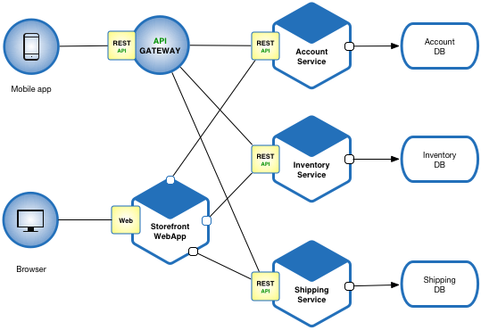
What is Microservice Architecture?
A design approach where a single application is built as a suite of small, independent services
Each service run at its own process and communicates via lightweight mechanism (e.g., API)
Focuses on modularity, scalability and flexibility

Slide 3
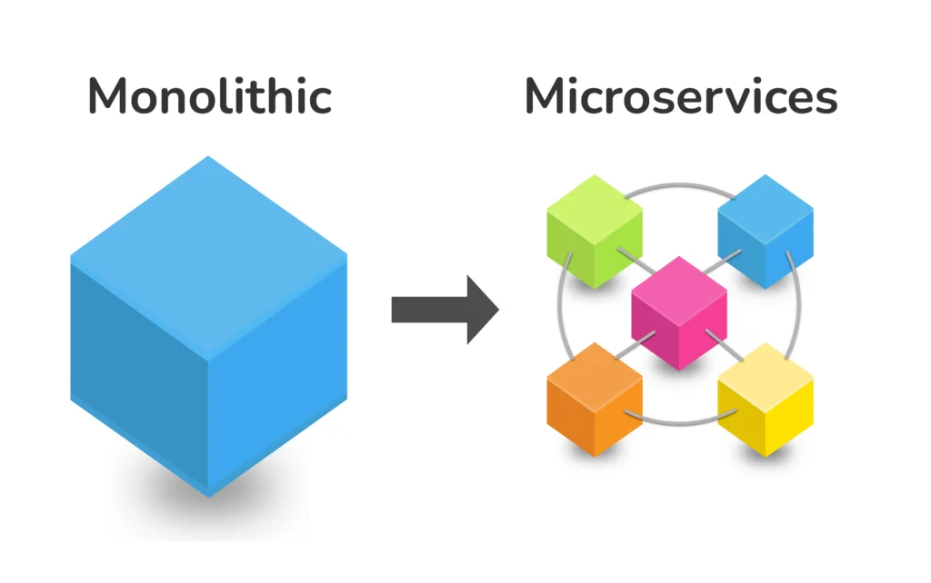
Microservices VS Monolithic Architecture
Monolithic Architecture:
Single codebase for entire app.
Tightly coupled components.
Scaling requires to work on the whole app.
Hard to adopt new tech.
Microservices:
Multiple independent services.
Loosely coupled, modular design.
Scale specific services only.
Flexible tech-agnostic (different languages can be used to implement different services)

Slide 4
Key Characteristics of Microservices
Independence: Each service is developed, deployed, and scaled independently
Decentralized: No central control; services use their own databases
Single Responsibility: Each service focuses on a specific business function
Interoperability: Services communicate using standard protocols (HTTP, Message brokers like Apache Kafka)

Slide 5
Benefits of Microservices
Scalability: Scale individual services based on demand
Flexibility: Use different technologies for different services
Faster Development: Small teams work on separate services in parallel
Resilience: Failure in one service does not affect the entire system

Slide 6
Challenges of Microservices
Complexity: Managing multiple services increases operational overhead
Communication: Inter-service communication can introduce latency
Infrastructure Cost: Independent CI/CD pipelines for each services increases cost
Testing: End-to-end testing across services is difficult
Application: Only applicable to a large software with multiple large teams with multiple services. Small companies cannot adopt it due to above mentioned challenges.

Slide 7




Real World Examples
Netflix in 2009 shifted from Monolithic to Microservices architecture.
The most significant shift involved breaking down customer-facing features like sign-up, movie selection, and configuration into separate, independent microservices.
Netflix completed the core migration to a microservices architecture by 2012.
Netflix now utilizes hundreds of microservices to power its streaming platform, enabling high scalability and frequent deployments.
Other Examples: Amazon, Uber, Airbnb etc.

Slide 8
Conclusion
Microservices offer scalability and flexibility but come with complexity
Ideal for large, dynamic systems but require careful design and management
Essential for modern software engineering in distributed environments

